Slide 1
CONCURRENCY CONTROL
Lecture 23

Slide 2
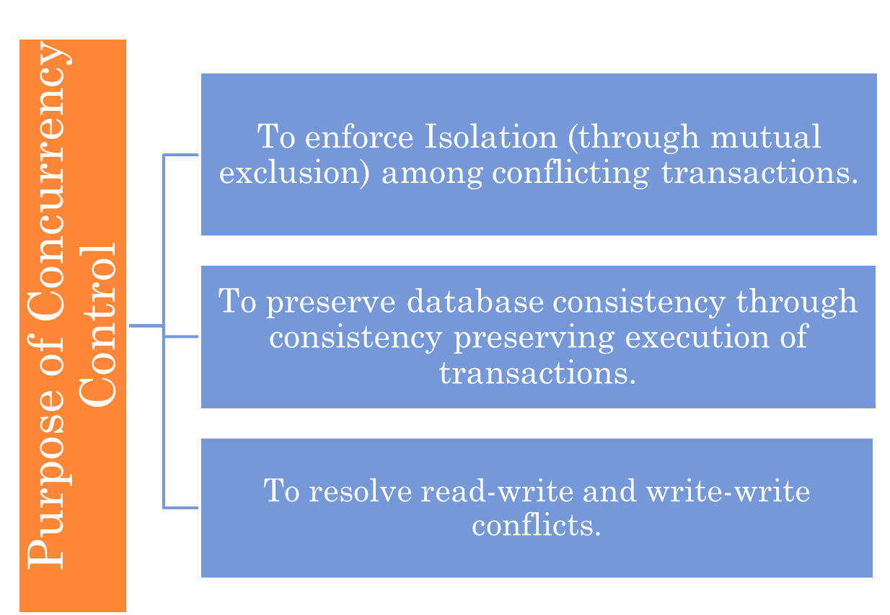
DATABASE CONCURRENCY CONTROL

Slide 3
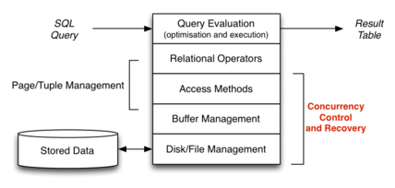

Slide 4
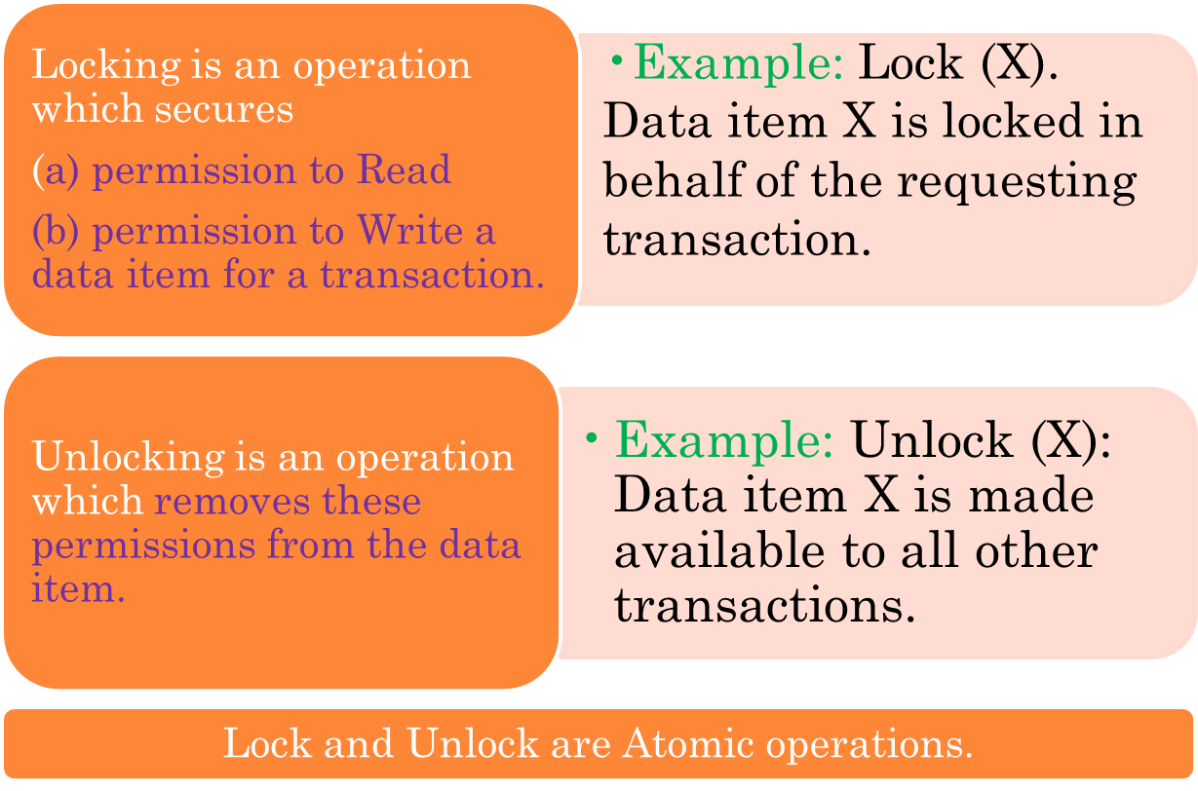
TWO-PHASE LOCKING TECHNIQUE

Slide 5
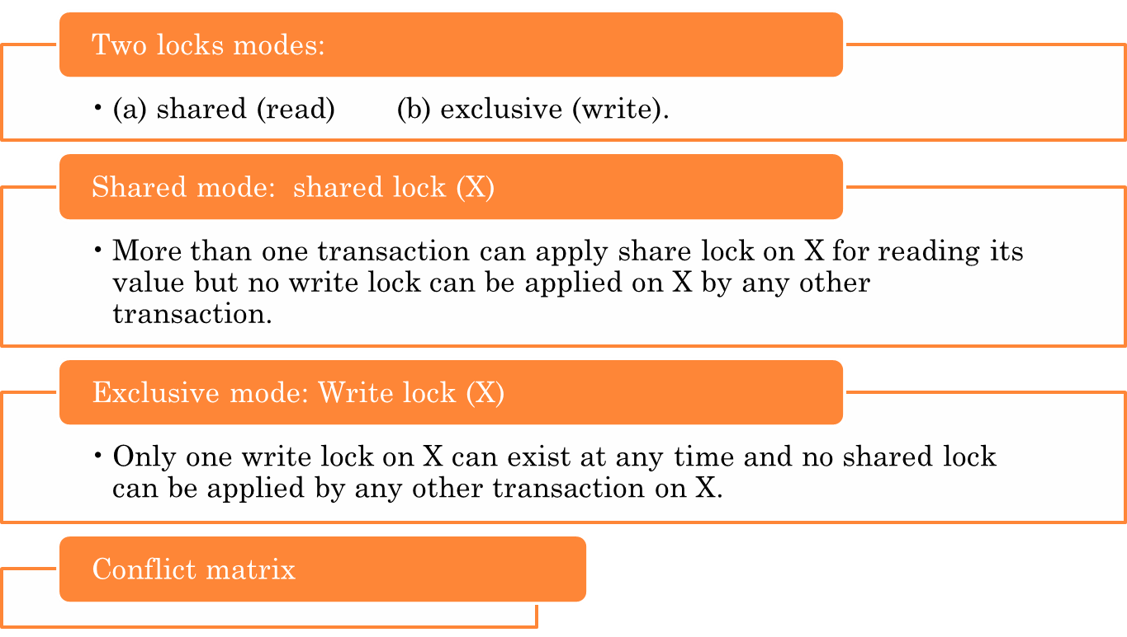
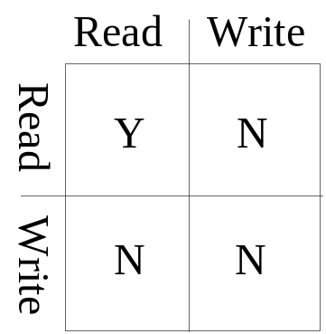
TWO-PHASE LOCKING TECHNIQUES: ESSENTIAL COMPONENTS

Slide 6
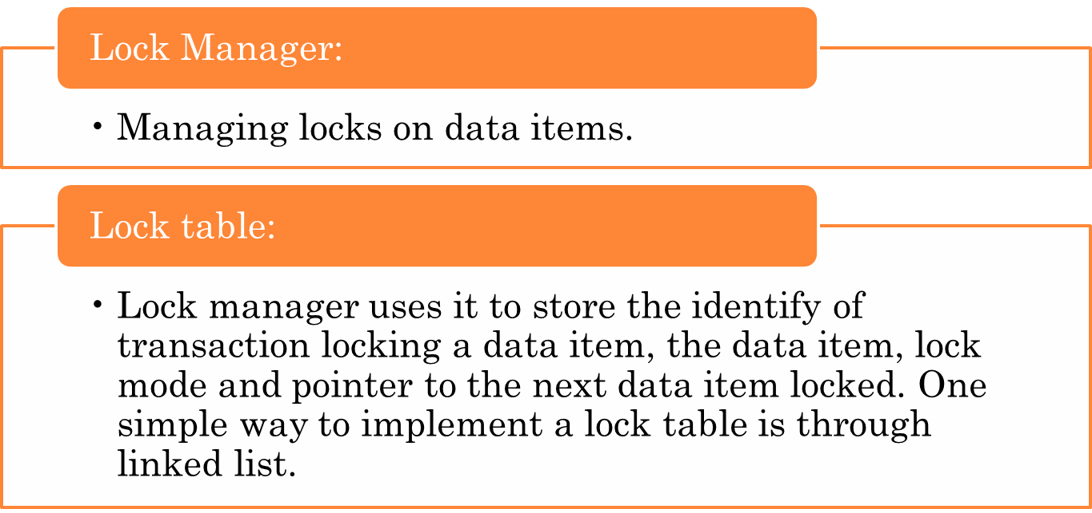
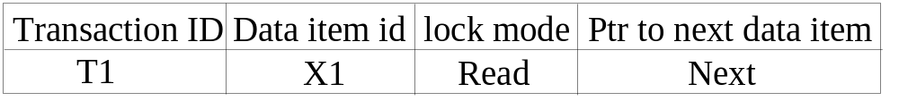
TWO-PHASE LOCKING TECHNIQUES: ESSENTIAL COMPONENTS

Slide 7
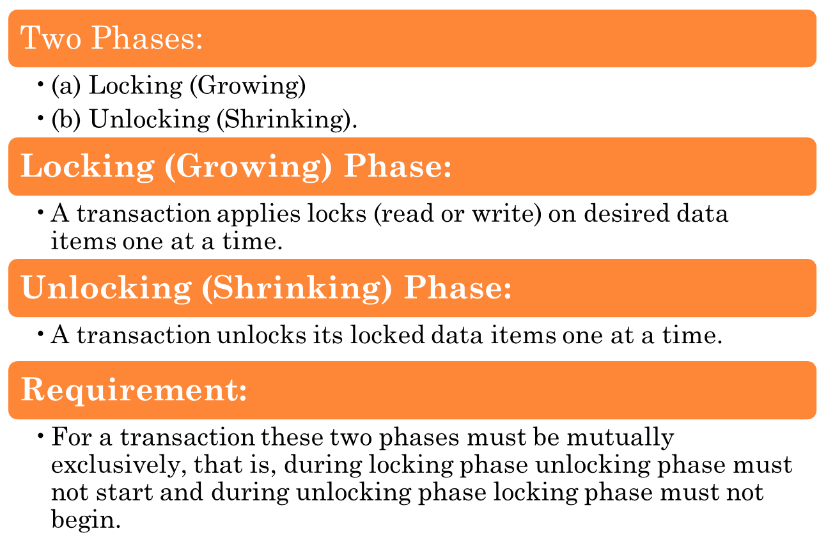
TWO-PHASE LOCKING TECHNIQUES:

Slide 8
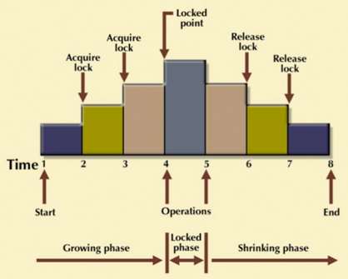

Slide 9
Two-Phase Locking Techniques: Example
T1 T2 Result
read_lock (Y); read_lock (X); Initial values: X=20; Y=30
read_item (Y); read_item (X); Result of serial execution
unlock (Y); unlock (X); T1 followed by T2
write_lock (X); Write_lock (Y); X=50, Y=80.
read_item (X); read_item (Y); Result of serial execution
X:=X+Y; Y:=X+Y; T2 followed by T1
write_item (X); write_item (Y); X=70, Y=50
unlock (X); unlock (Y);

Slide 10
Two-Phase Locking Techniques: Example
T1 T2 Result
read_lock (Y); X=50; Y=50
read_item (Y); Nonserializable because it.
unlock (Y); violated two-phase policy.
read_lock (X);
read_item (X);
unlock (X);
write_lock (Y);
read_item (Y);
Y:=X+Y;
write_item (Y);
unlock (Y);
write_lock (X);
read_item (X);
X:=X+Y;
write_item (X);
unlock (X);
Time

Slide 11
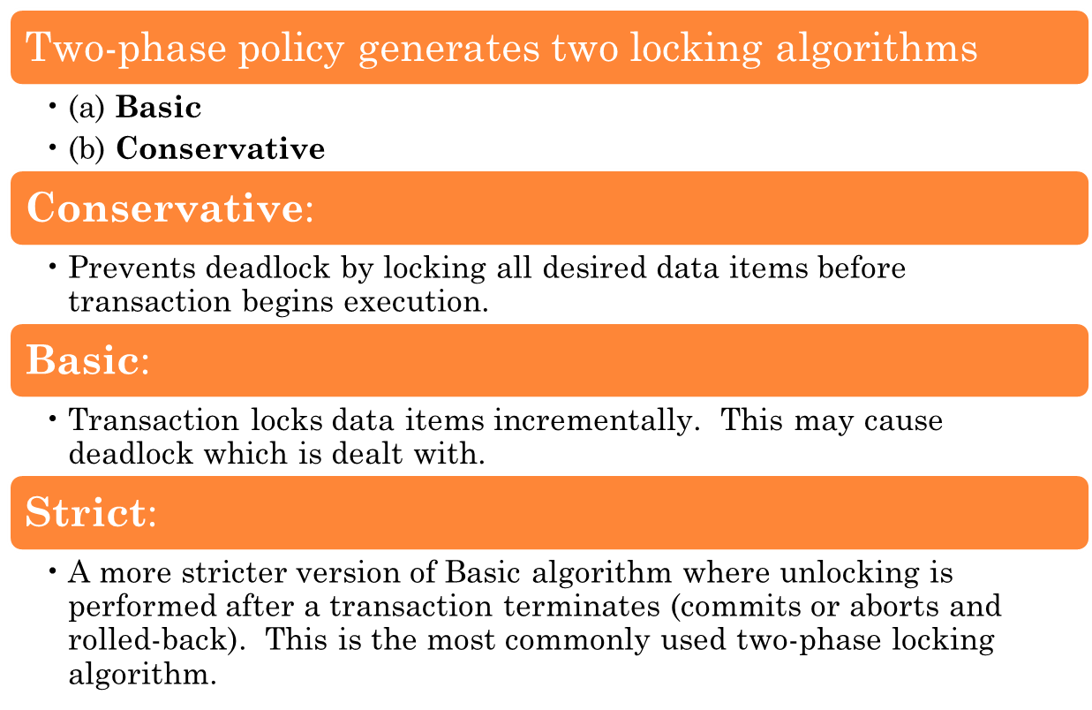
TWO-PHASE LOCKING TECHNIQUES:

Slide 12
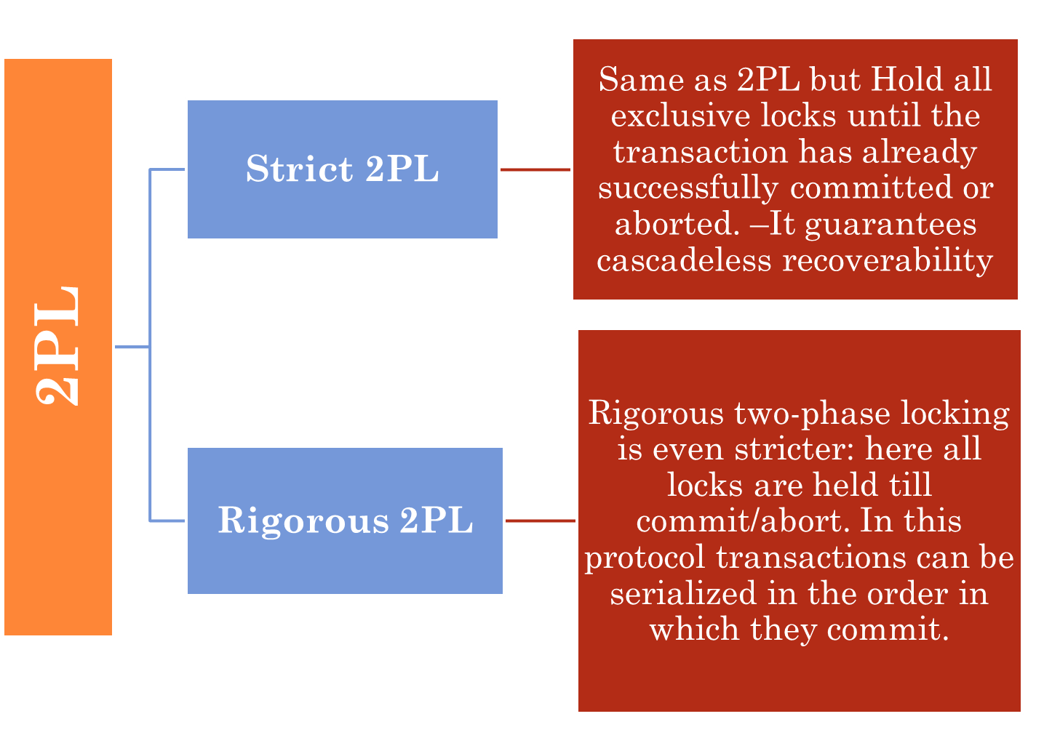

Slide 13
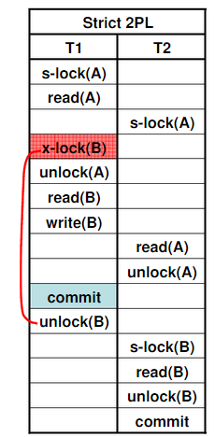
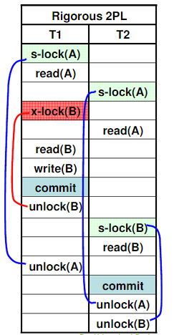

Slide 14
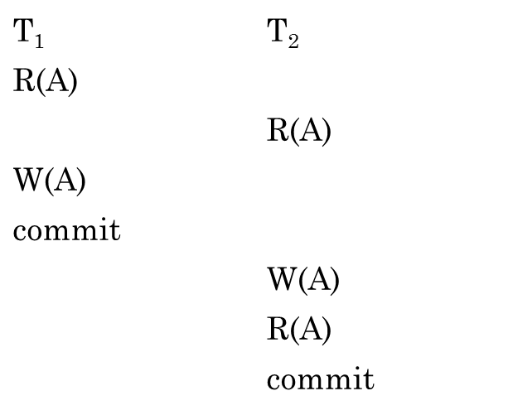
PRACTICE PROBLEM
Consider the following schedule involving two transactions T₁ and T₂.
Identify the Type of Schedule?

Slide 15
PRACTICE PROBLEM SOLUTION
Consider the following schedule involving two transactions T₁ and T₂.
This is a strict schedule since T₂ reads and writes A which is written by T₁ only after the commit of T₁.

Slide 16
PRACTICE PROBLEM
Consider the following database schedule with
two transactions, T1 and T2.
S = r2(X); r1(X); r2(Y); w1(X); r1(Y); w2(X); a1; a2;
where ri(Z) denotes a read operation by transaction Ti
on a variable Z, wi(Z) denotes a write operation by Ti on
a variable Z and ai denotes an abort by transaction Ti .Which one
of the following statements about the above schedule is TRUE?
(A) S is non-recoverable
(B) S is recoverable, but has a cascading abort
(C) S does not have a cascading abort
(D) S is strict

Slide 17
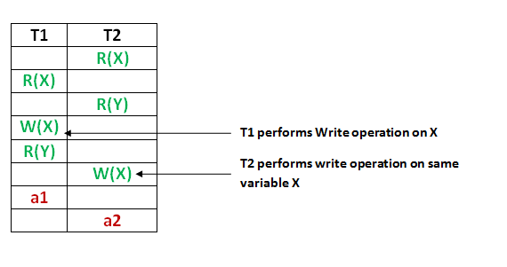
PRACTICE PROBLEM SOLUTION

Slide 18
PRACTICE PROBLEM SOLUTION
As we can see in figure,
T2 overwrites a value that T1 writes
T1 aborts: its “remembered” values are restored.
Cascading Abort could have arised if – > Abort of T1 required abort of T2 but as T2 is already aborted , its not a cascade abort. Therefore, Option C
Option A – is not true because the given schedule is recoverable
Option B – is not true as it is recoverable and avoid cascading aborts;
Option D – is not true because T2 is also doing abort operation after T1 does, so NOT strict.

Slide 19
DEALING WITH DEADLOCK AND STARVATION
  Deadlock
T’1 T’2
read_lock (Y); T1 and T2 did follow two-phase
read_item (Y); policy but they are deadlock
read_lock (X);
read_item (Y);
write_lock (X);
(waits for X) write_lock (Y);
(waits for Y)
  Deadlock (T’1 and T’2)

Slide 20
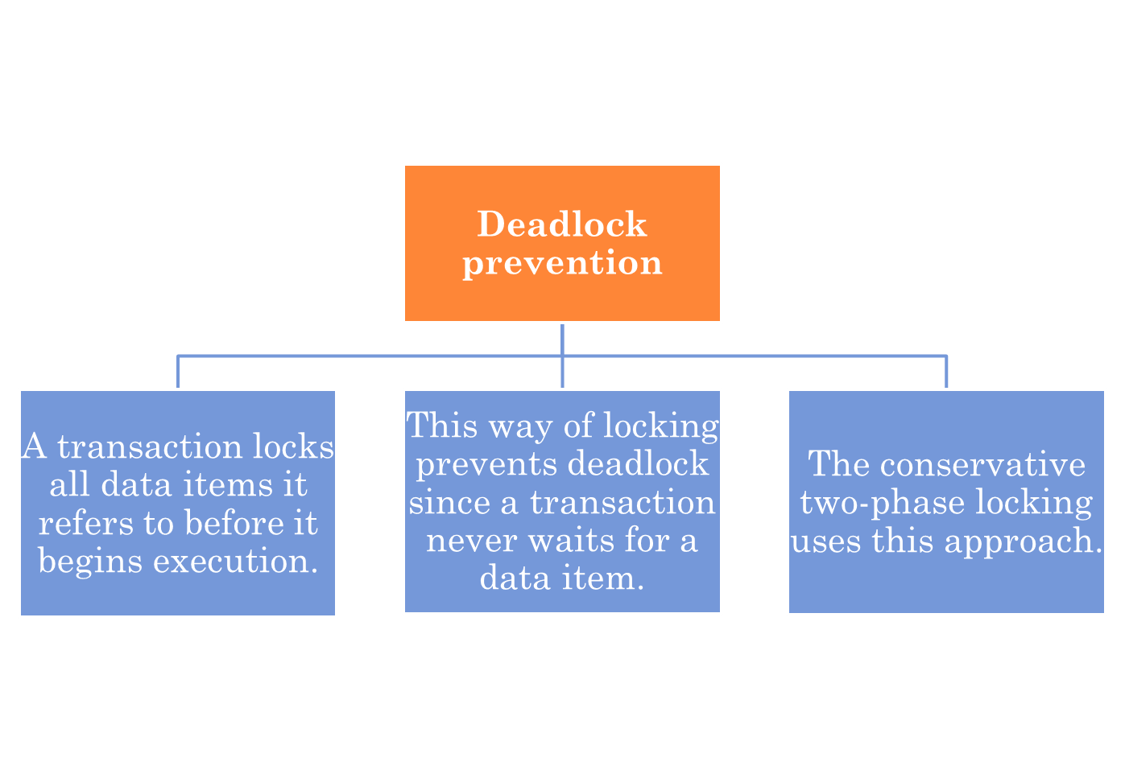
DEALING WITH DEADLOCK AND STARVATION

Slide 21
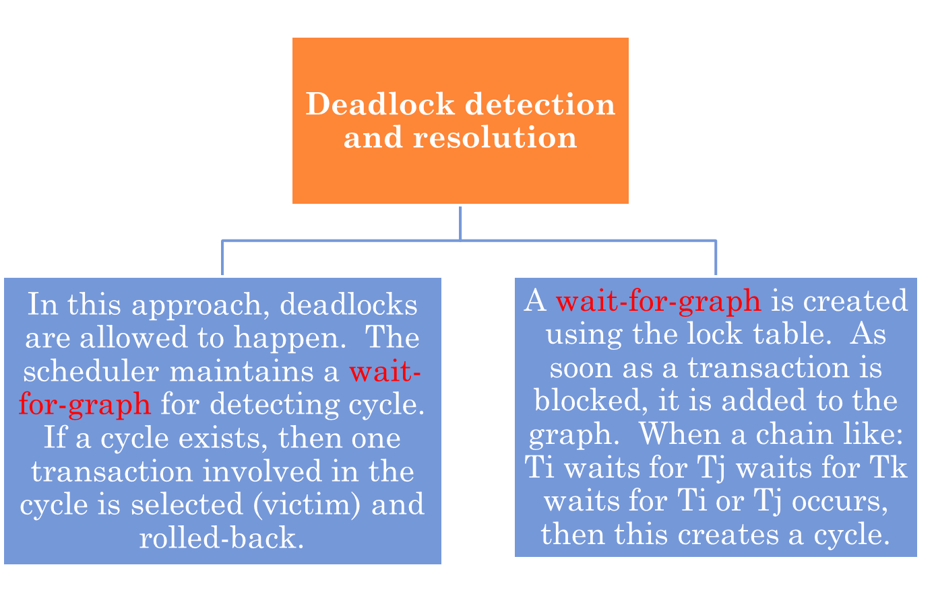
DEALING WITH DEADLOCK AND STARVATION

Slide 22
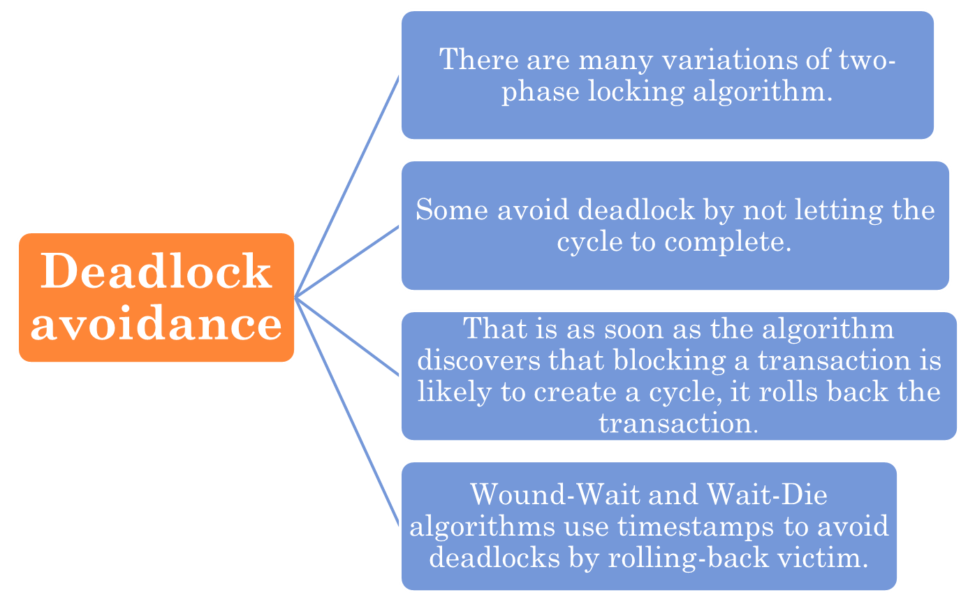
DEALING WITH DEADLOCK AND STARVATION

Slide 23
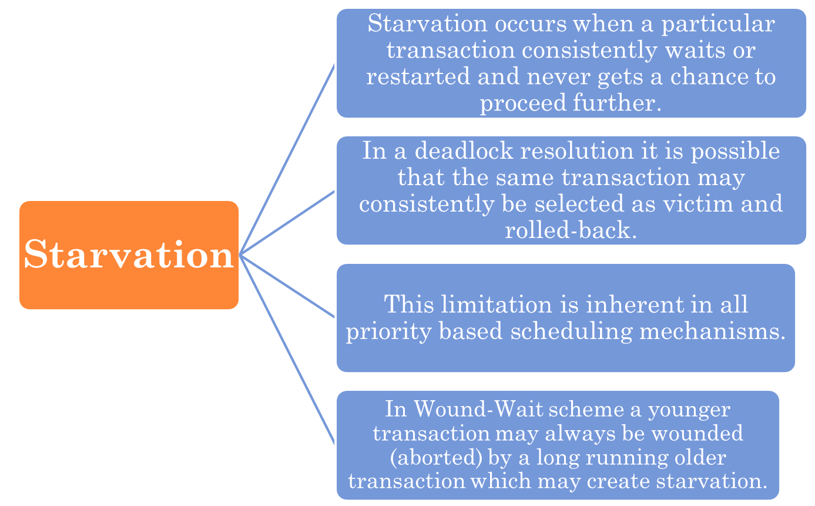
DEALING WITH DEADLOCK AND STARVATION

Slide 24
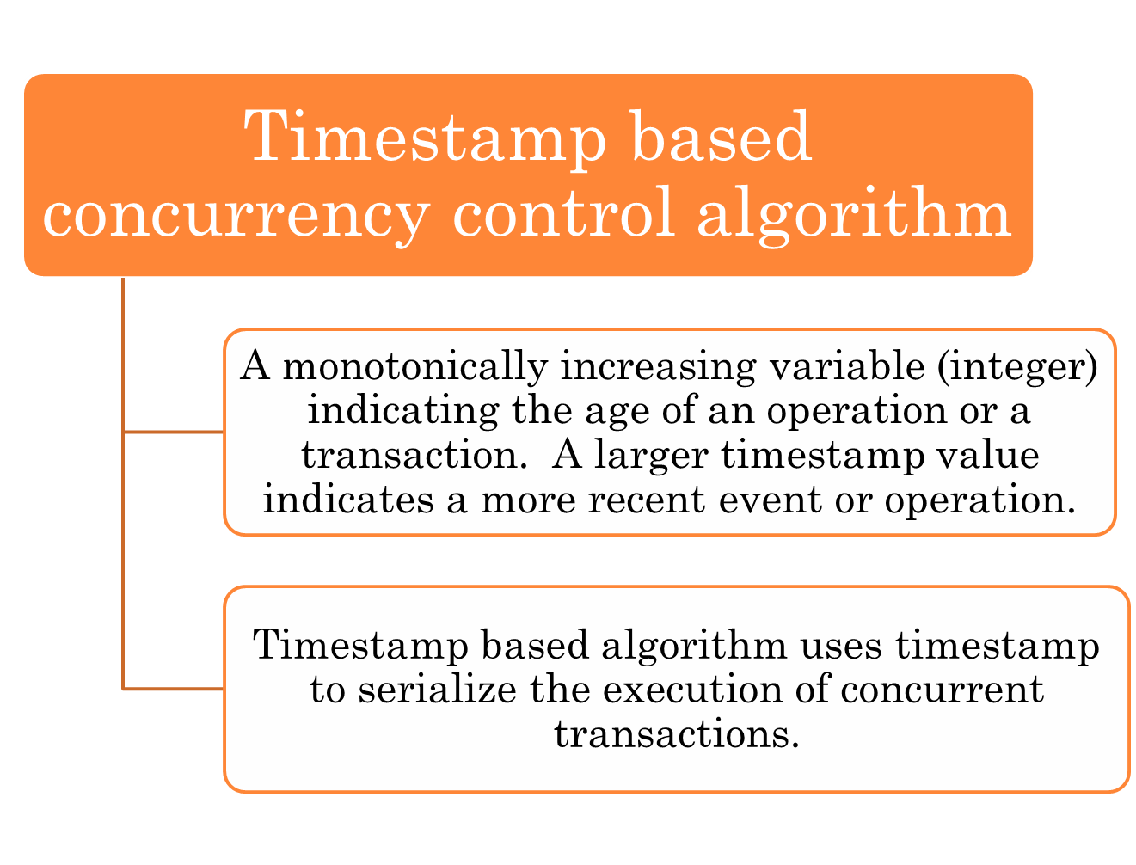

Slide 25
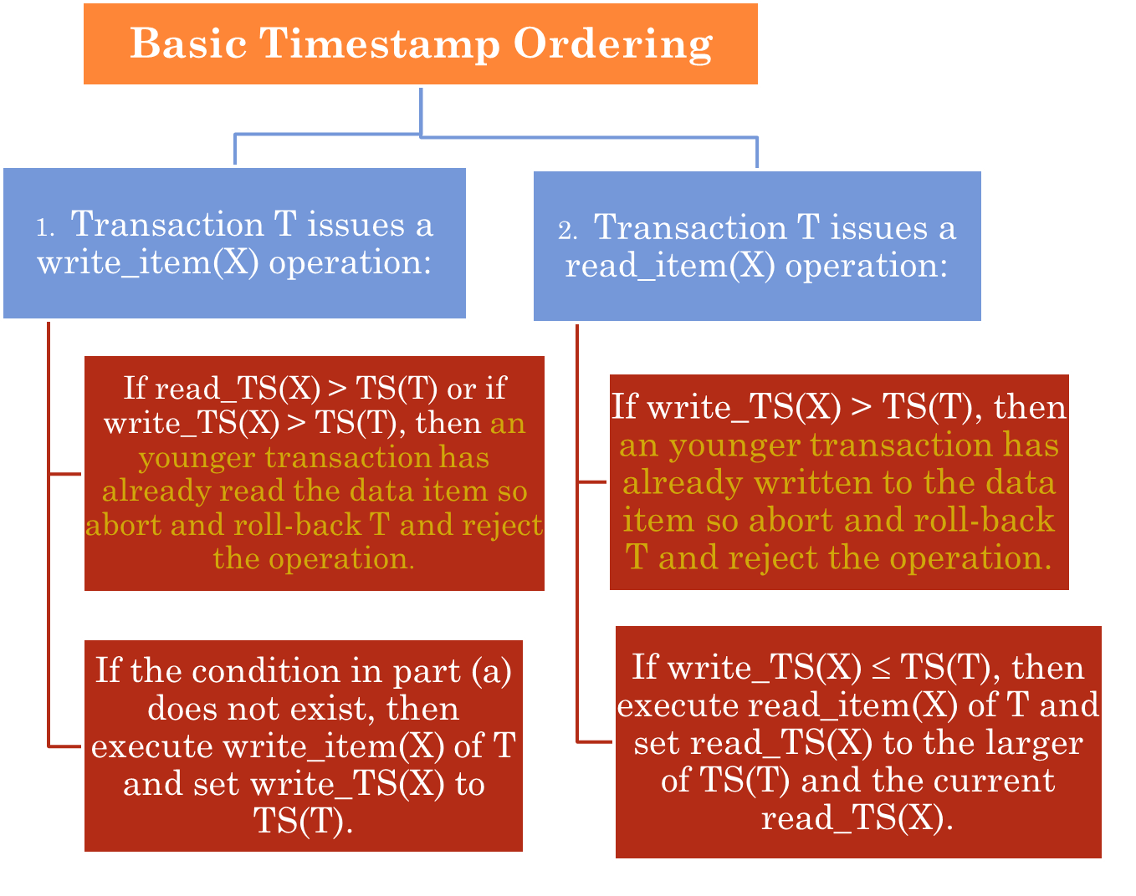

Slide 26
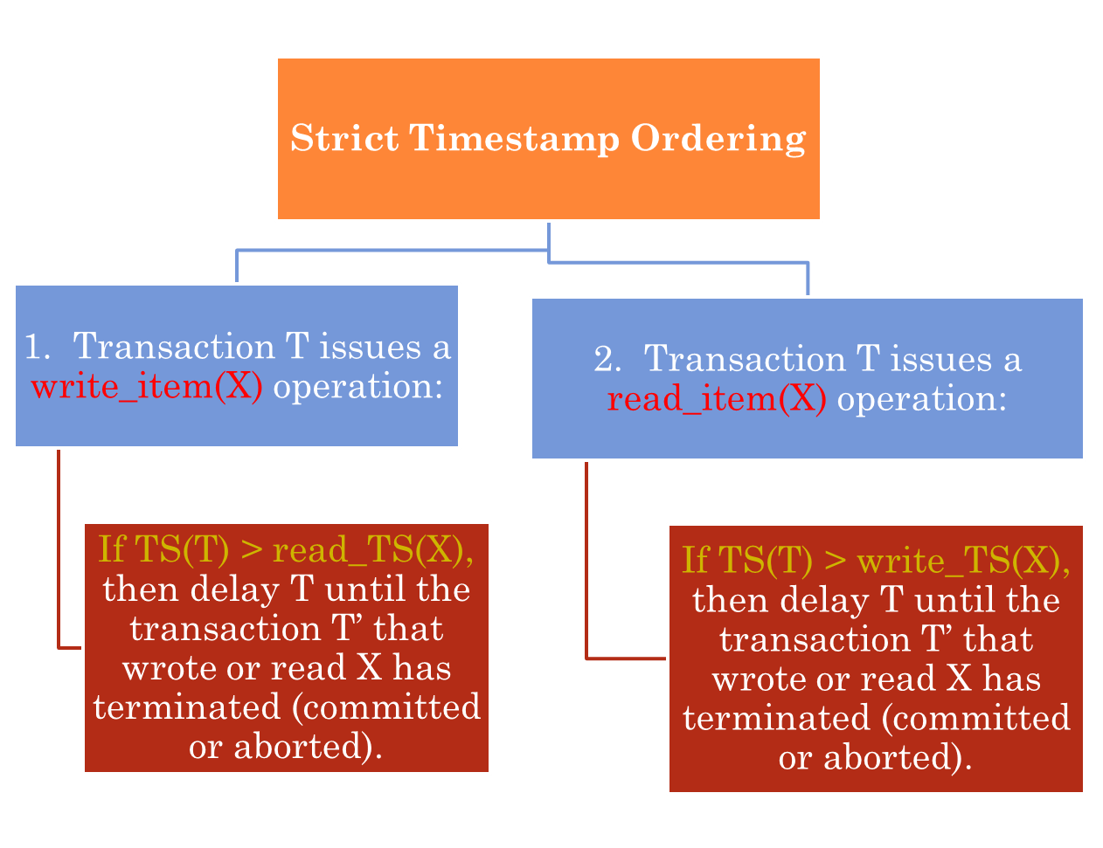

Slide 27
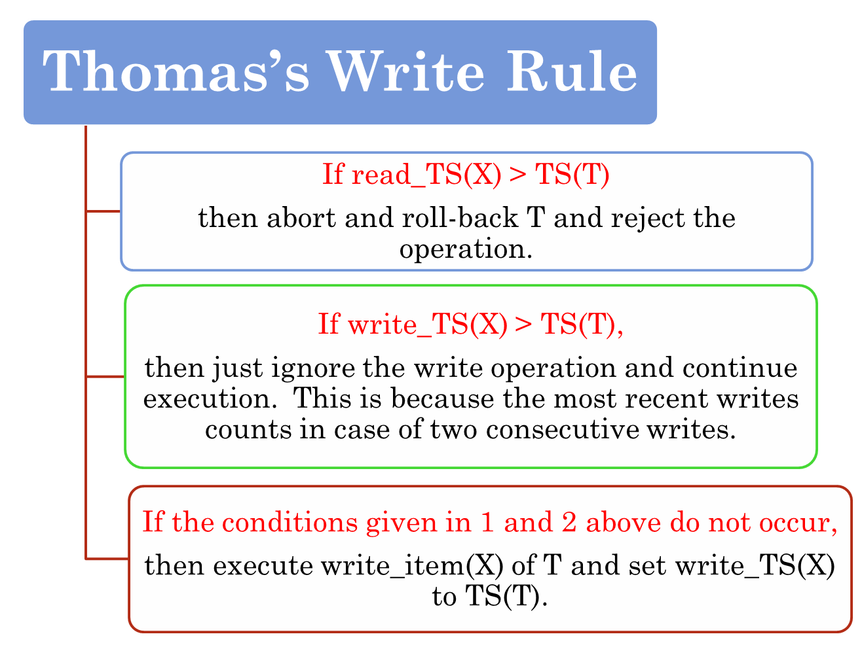

Slide 28
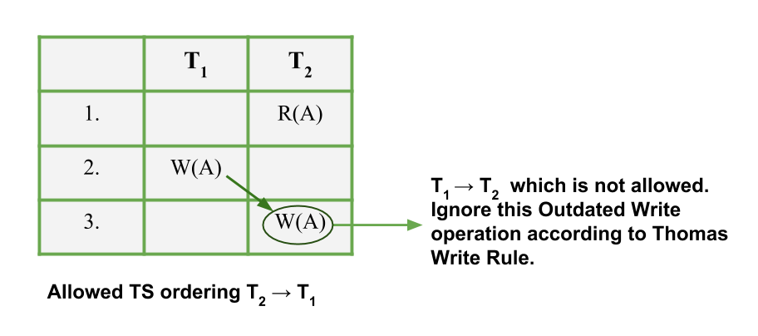
PRACTICE EXAMPLE
Suppose user has a schedule in which two transactions T₁ and T₂. Now, TS(T₁) < TS(T₂). This means T₁ arrived after T₂ and hence has a larger TS value than T₁. This implies that serializablity of schedule allowed is T₂ –> T₁ . Consider the partial schedule given below:

Slide 29
PRACTICE EXAMPLE
Suppose user has a schedule in which two transactions T₁ and T₂. Now, TS(T₁) < TS(T₂).
This implies that serializablity of schedule allowed is T₂ –> T₁ . Consider the two protocols, let us see what types of Operation will be allowed and not allowed under them. R_{i}(A) implies Read and W_{i}(A) implies Write operation.
Basic TO Protocol Not Allowed R₁(X) W₂(X) W₁(X) R₂(X) W₁(X) W₂(X) Allowed All operations where T₂ occurs before T₁. R₁(X) R₂(X) | Thomas Write Rule Not Allowed R₁(X) W₂(X) W₁(X) R₂(X) Allowed All operations where T₂ occurs before T₁. Outdated Writes: W₁(X) W₂(X) R₁(X) R₂(X)

Slide 30
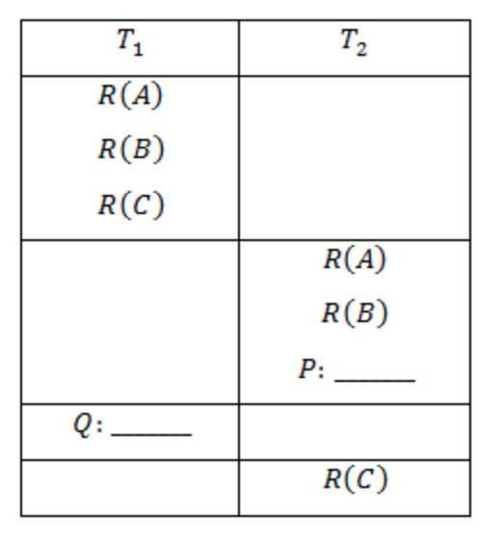
PRACTICE PROBLEM
Consider the following schedule:
The possible values of P & Q for which the above schedule is allowed under Thomas write rule but not under basic timestamp ordering protocol if timestamp(T₂ )>timestamp(T₁ )
W(B),W(C)
W(A),W(A)
Both (a)&(b)
None of these

Slide 31
PRACTICE PROBLEM SOLUTION
Option 1 : We haven't any W->W or W->R or R->W dependency from T2 to T1, So Option 1 is valid for Simple TimeStamp. and so, valid for TWR (bcz in TWR we can even ignore W->W dependency).
Option 2 : There will be W(A)->W(A) dependency from T2 to T1, which voilate Simple TimeStamp Rule but valid for TWR (bcz TWR will be voilate only if W->R or R->W dependency is here from T2 to T1)
So Option 2
Note: It should be given that TimeStamp of T2 is greater than that of T1.

Slide 32
PRACTICE PROBLEM
Consider the following schedule involving two transactions T₁ and T₂.
Identify the Type of Schedule?

Slide 33
PRACTICE PROBLEM SOLUTION
Consider the following schedule involving two transactions T₁ and T₂.
This is a strict schedule since T₂ reads and writes A which is written by T₁ only after the commit of T₁.

Slide 34
PRACTICE PROBLEM
Consider the following database schedule with
two transactions, T1 and T2.
S = r2(X); r1(X); r2(Y); w1(X); r1(Y); w2(X); a1; a2;
where ri(Z) denotes a read operation by transaction Ti
on a variable Z, wi(Z) denotes a write operation by Ti on
a variable Z and ai denotes an abort by transaction Ti .Which one
of the following statements about the above schedule is TRUE?
(A) S is non-recoverable
(B) S is recoverable, but has a cascading abort
(C) S does not have a cascading abort
(D) S is strict

Slide 35
PRACTICE PROBLEM SOLUTION

Slide 36
PRACTICE PROBLEM SOLUTION
As we can see in figure,
T2 overwrites a value that T1 writes
T1 aborts: its “remembered” values are restored.
Cascading Abort could have arised if – > Abort of T1 required abort of T2 but as T2 is already aborted , its not a cascade abort. Therefore, Option C
Option A – is not true because the given schedule is recoverable
Option B – is not true as it is recoverable and avoid cascading aborts;
Option D – is not true because T2 is also doing abort operation after T1 does, so NOT strict.

Slide 37
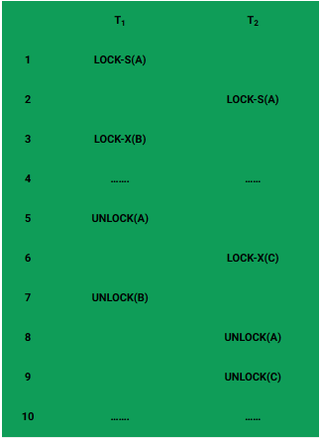
PRACTICE PROBLEM
Consider the following schedule involving two transactions T₁ and T₂.
Is this transaction implements 2PL?

Slide 38
PRACTICE PROBLEM SOLUTION
Yes this transaction implements 2PL
This is just a skeleton transaction which shows how unlocking and locking works with 2-PL. Note for:
Transaction T₁:
Growing Phase is from steps 1-3.
Shrinking Phase is from steps 5-7.
Lock Point at 3
Transaction T₂:
Growing Phase is from steps 2-6.
Shrinking Phase is from steps 8-9.
Lock Point at 6

Slide 39
PRACTICE EXAMPLE
Suppose user has a schedule in which two transactions T₁ and T₂. Now, TS(T₁) < TS(T₂). This means T₁ arrived after T₂ and hence has a larger TS value than T₁. This implies that serializablity of schedule allowed is T₂ –> T₁ . Consider the partial schedule given below:

Slide 40
PRACTICE EXAMPLE
Suppose user has a schedule in which two transactions T₁ and T₂. Now, TS(T₁) < TS(T₂).
This implies that serializablity of schedule allowed is T₂ –> T₁ . Consider the two protocols, let us see what types of Operation will be allowed and not allowed under them. R_{i}(A) implies Read and W_{i}(A) implies Write operation.
Basic TO Protocol Not Allowed R₁(X) W₂(X) W₁(X) R₂(X) W₁(X) W₂(X) Allowed All operations where T₂ occurs before T₁. R₁(X) R₂(X) | Thomas Write Rule Not Allowed R₁(X) W₂(X) W₁(X) R₂(X) Allowed All operations where T₂ occurs before T₁. Outdated Writes: W₁(X) W₂(X) R₁(X) R₂(X)

Slide 41
PRACTICE PROBLEM
Consider the following schedule:
The possible values of P & Q for which the above schedule is allowed under Thomas write rule but not under basic timestamp ordering protocol if timestamp(T₂ )>timestamp(T₁ )
W(B),W(C)
W(A),W(A)
Both (a)&(b)
None of these

Slide 42
PRACTICE PROBLEM SOLUTION
Option 1 : We haven't any W->W or W->R or R->W dependency from T2 to T1, So Option 1 is valid for Simple TimeStamp. and so, valid for TWR (bcz in TWR we can even ignore W->W dependency).
Option 2 : There will be W(A)->W(A) dependency from T2 to T1, which voilate Simple TimeStamp Rule but valid for TWR (bcz TWR will be voilate only if W->R or R->W dependency is here from T2 to T1)
So Option 2
Note: It should be given that TimeStamp of T2 is greater than that of T1.

Slide 43
PRACTICE PROBLEM
Is it conflict serializable, view serializable, serializable, recoverable, avoids cascading aborts, strict?
T1:W(X), T2:R(Y), T1:R(Y), T2:R(X)

Slide 44
PRACTICE PROBLEM SOLUTION
Is it conflict serializable, view serializable, serializable, avoids cascading aborts, strict?
T1:W(X), T2:R(Y), T1:R(Y), T2:R(X)
YES! conflict serializable–
YES! view serializable–
YES! serializable–
NO! avoids cascading aborts
NO! strict

Slide 45
THANKS!!

